Slide 1


Lemon Jelly Café
Cloud Application Management Project Platform: Microsoft Azure Team Members: Rahul Sheroy Shinod(20065316) Akanksha Srivastava(20078801) Yash Purohit(20074160)

Slide 2

Introduction to Cloud Computing
On‑demand access to IT resources
Reduces need for physical infrastructure
Highly scalable and flexible
Accessible from anywhere
Ideal for SMEs in hospitality

Slide 3
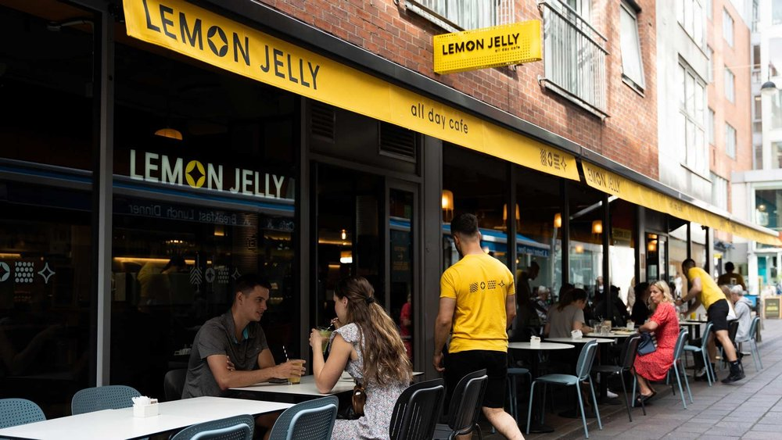
Business Overview
Located at Millennium Walkway, Dublin
130+ total seating (indoor + outdoor)
15–20 employees
4.6★ rating with 7000+ reviews
Popular among locals and tourists

Slide 4
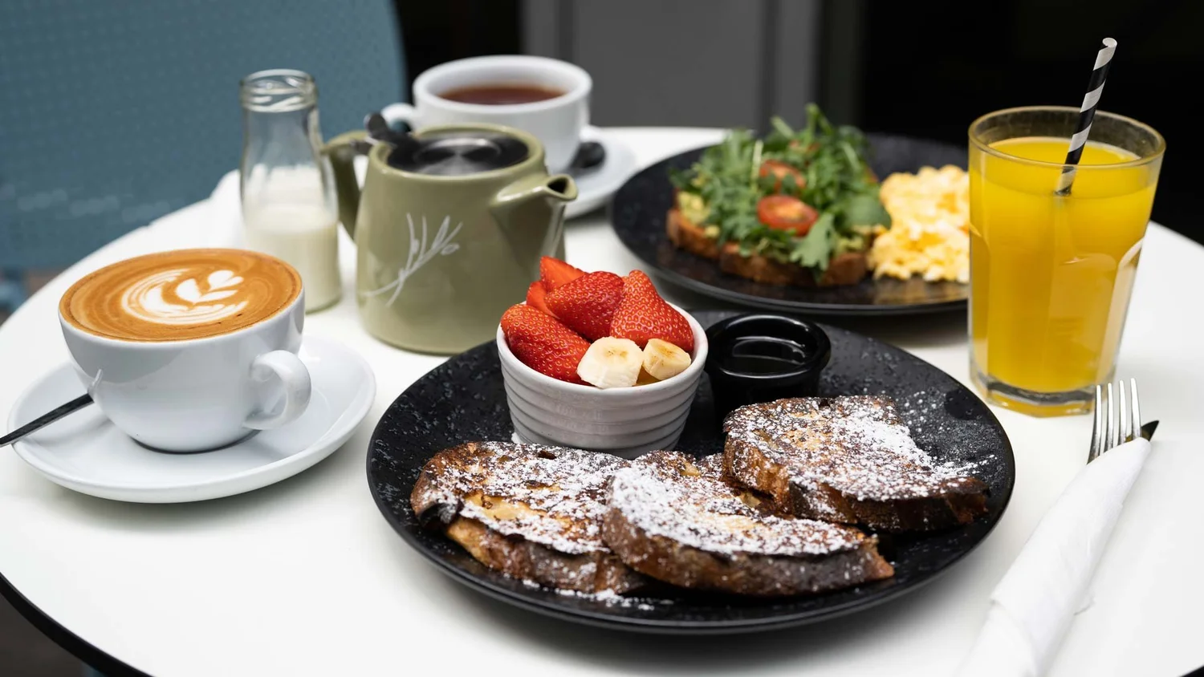
Menu & Operations
Breakfast, brunch, lunch
Fresh ingredients daily
Wide menu variety
Requires strong inventory control
Complex daily operations

Slide 5

Online Presence
Main website + separate ordering site
Instagram, Facebook, TripAdvisor
7900+ followers
Systems not integrated
Limited customer data ownership

Slide 6

Key Business Challenges
Manual inventory management
Unstructured staff scheduling
Disconnected IT systems
Poor data visibility
Limited scalability

Slide 7
Current IT Infrastructure
Standalone POS
Manual spreadsheets
No CRM
Shared hosting website
No formal backup strategy

Slide 8

Cloud POS Solution
SaaS POS (Square)
Real‑time sales dashboards
Integrates with inventory & accounting
Remote access
Better analytics

Slide 9

Azure Website & Ordering
Host website on Azure
Integrated ordering system
No third‑party commission fees
Full control of customer data
Scalable during peak hours

Slide 10
Inventory Management
Cloud‑based inventory system
Real‑time stock tracking
Low‑stock alerts
Waste reduction
Better supplier ordering

Slide 11
Data Storage & CRM
Azure Blob Storage backups
Automated secure storage
CRM (HubSpot)
Customer behaviour insights
Targeted marketing

Slide 12

Network & Deployment
Cloud‑managed network (UniFi)
Azure VM hosts web app
Azure SQL Database
Blob Storage for backups
Fully integrated cloud system

Slide 13
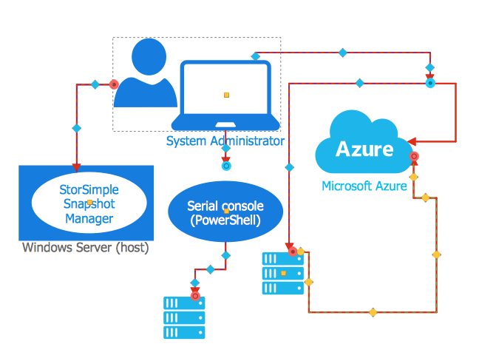
Azure Architecture Diagram
Flow: User → Azure VM (Web App) → Azure SQL Database → Azure Blob Storage
VM handles website + ordering
SQL stores menu, orders, staff
Blob stores automated backups

Slide 14
Conclusion
Cloud improves efficiency
Enhances data security
Enables scalability
Reduces long‑term costs
Phased implementation recommended

Slide 15
Thank You

